Slide 1


Slide 2

Questions?

Slide 3
Class 4 - Review
For Loops
Python reserved words None, is, is not
For loops applications
More on fluxograms
Algorithms development (Loops with decision structures)
Debugging on spyder
More on documentation
More on string methods (isupper(), capitalize(), find())
Type Conversion int()

Slide 4
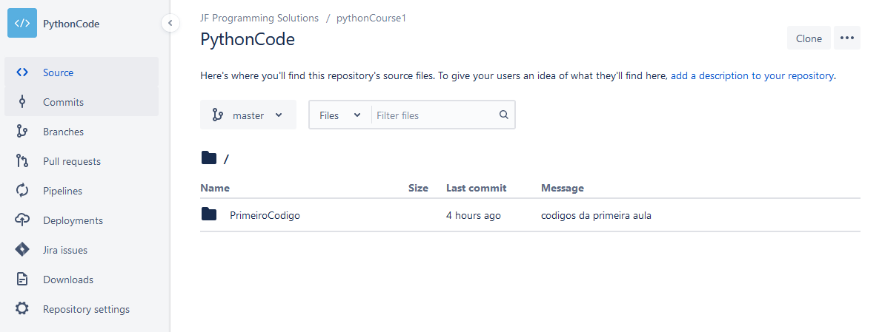

Slide 5
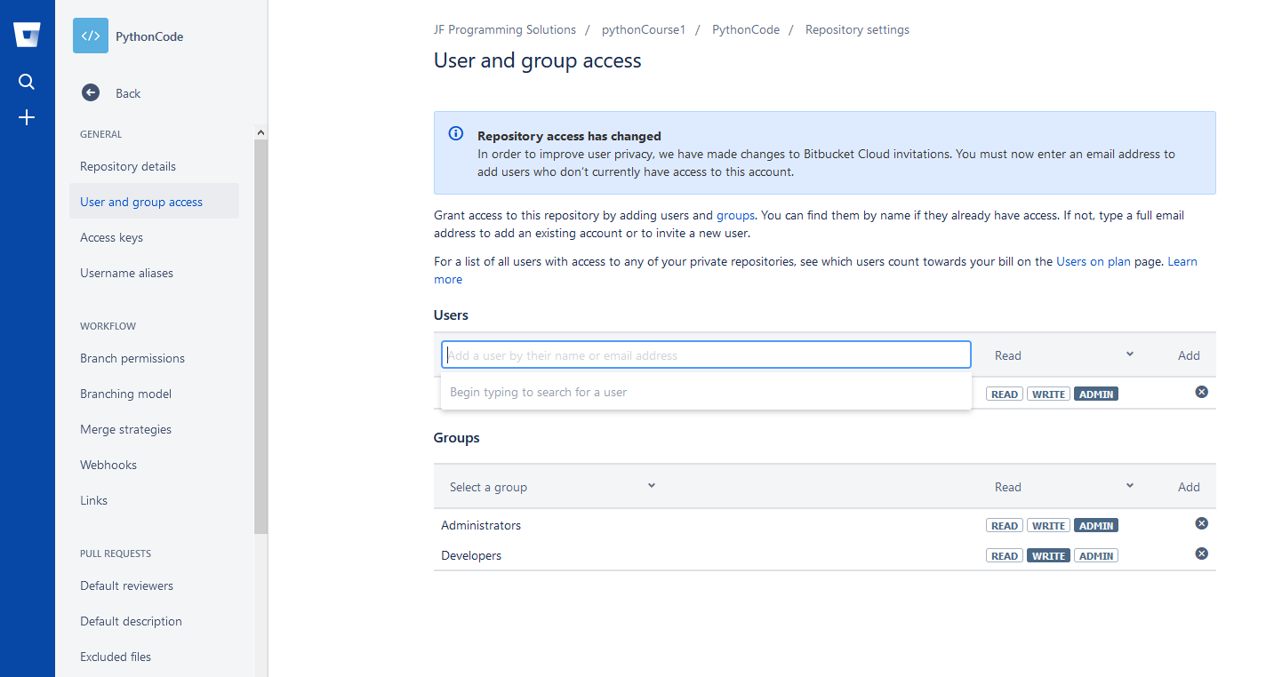
josi_ocroch@hotmail.com

Slide 6
Functions introduction
my_
function()
Parameter/Parameters
Result/Results
A function is some stored code that we could reuse. A function takes some input and produces an output.

Slide 7
Stored (and reused) Steps
def
def thing():
print('Hello')
print('Fun')
thing()
print('Zip')
thing()
thing():
Output:
Hello
Fun
Zip
Hello
Fun
print('Hello')
print('Fun')
thing()
print('Zip')
thing()

Slide 8
Python Functions
Built-in functions that are provided as part of Python print(), input(), int() float() string() type()
Functions that we define ourselves and then use
We define a function using the def reserved word

Slide 9
Building our Own Functions
We create a new function using the def keyword followed by optional parameters in parentheses
We indent the body of the function
This defines the function but does not execute the body of the function
def music_lyrics():
print("We are here")
print("We are here for all of us")

Slide 10
Arguments
An argument is a value we pass into the function as its input when we call the function
We use arguments so we can direct the function to do different kinds of work when we call it at different times
We put the arguments in parentheses after the name of the function
number = int(‘2’, “Josi”, 1.90)
Arguments

Slide 11
Parameters
def food(vegetable):
if vegetable == ‘tomato’:
print(‘I bought tomato)
elif vegetable == ‘orange’:
print(‘I bought orange’)
else:
print(‘I bought other vegetable’)
food(‘tomato’)
I bought tomato
A parameter is a variable which we use in the function definition.

Slide 12
Return Values
Often a function will take its arguments, do some computation, and return a value to be used as the value of the function call in the calling expression. The return keyword is used for this.
def greet():
return "Hello"
print(greet(), “Rodrigo")
print(greet(), “João")
Hello Rodrigo
Hello João

Slide 13
Arguments, Parameters, and Results
result = my_func('Hello world')
print(result)
w
Parameter
def my_func(str):
blah
blah
for x in inp:
blah
blah
return 'w'
'Hello world'
'w'
Argument
Result

Slide 14
Multiple Parameters / Arguments
We can define more than one parameter in the function definition
We simply add more arguments when we call the function
We match the number and order of arguments and parameters
def addtwo(a, b):
added = a + b
subtracao = a -b
return added, subtracao
x = addtwo(3, 5)
print(x)

Slide 15
Global and local Variables
def food():
eggs = ‘food local’
print(eggs) # prints ‘food local'
def more_food():
eggs = ‘more_food local’
print(eggs) # prints ‘more_food local’
food()
print(eggs) # prints ‘more_food local’
eggs = 'global’
more_food()
print(eggs) # prints 'global'
def food():
bread=‘white bread’
x = food()
print(bread)

Slide 16
Assignments operators
a = 21 b = 10 c = 0
c = a + b
c += a
c *= a
c /= a
c = 2
c %= a
c **= a
c //= a

Slide 17
Bit operators
a = 10 # 10 = 1010
b = 3 # 3 = 0011
hifen =30
binary = bin(a & b);
denary = a & b
print ("Line 1 - Value of binary is ", binary)
print ("Line 1 - Value of denary is ", denary)
print("-"*hifen)
binary = bin(a | b);
denary = (a | b)
print ("Line 1 - Value of binary is ", binary)
print ("Line 1 - Value of denary is ", denary)
print("-"*hifen)
binary = bin(a << 2)
denary = a << 2;
print ("Line 1 - Value of binary is ", binary)
print ("Line 1 - Value of denary is ", denary)
print("-"*hifen)
binary = bin(a >> 2);
denary = a >> 2;
print ("Line 1 - Value of binary is ", binary)
print ("Line 1 - Value of denary is ", denary)
print("-"*hifen)
binary = bin(~a);
denary =~a;
print ("Line 1 - Value of binary is ", binary)
print ("Line 1 - Value of denary is ", denary)
print("-"*hifen)
binary = bin(a ^ b);
denary =a ^ b;
print ("Line 1 - Value of binary is ", binary)
print ("Line 1 - Value of denary is ", denary)
print("-"*hifen)

Slide 18
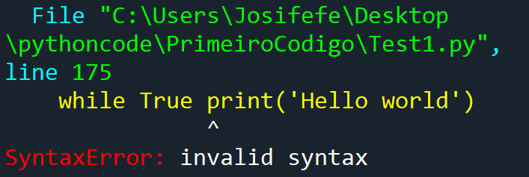
Error messages in Python
Syntax errors known as parse errors. The parser repeats the invalid line and has a small ‘arrow’ pointing to the point on the line where the error was detected.
A program with a runtime error is one that passed the interpreter’s syntax checks, and started to execute. However, during the execution of one of the statements in the program, an error occurred that caused the interpreter to stop executing the program and display an error message.
If there is a semantic error in your program, it will run successfully in the sense that the computer will not generate any error messages. However, your program will not do the right thing. Bug

Slide 19
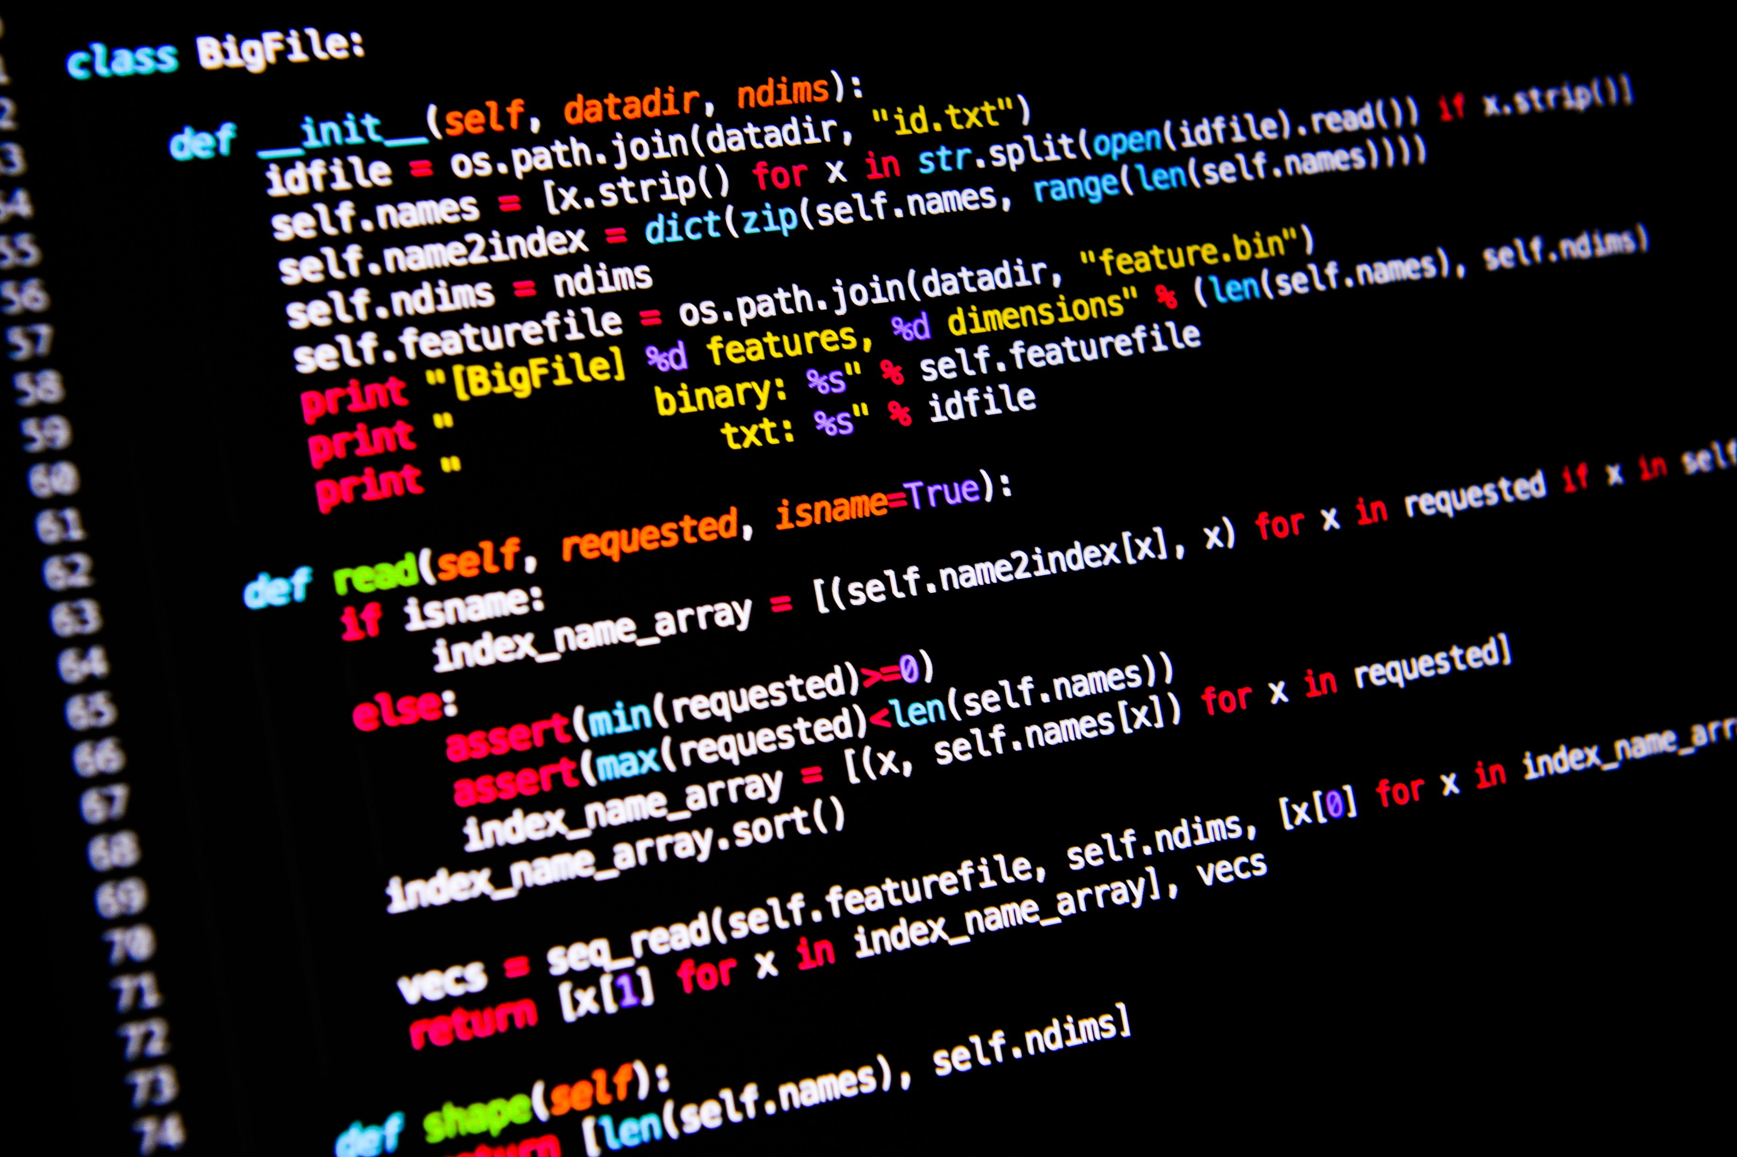
<WELCOME >
<Exercise – 1-2>

Slide 20
Exercise 1
Implement a function that receives a number as parameter and prints, in decreasing order, which numbers are even and which are odd, until it reaches 0. >>> even_odd(10) Even number: 10 Odd number: 9 Even number: 8 Odd number: 7 Even number: 6 Odd number: 5 Even number: 4 Odd number: 3 Even number: 2 Odd number: 1

Slide 21
Exercise 2
Write a function that receives a list of numbers and returns the arithmetic mean of the numbers in [2, 61, -1, 0, 88, 55, 3, 121, 25, 75]
The following function must be implemented:
def mean(v):

Slide 22
<WELCOME >
<REVISION>

Slide 23


